Slide 1
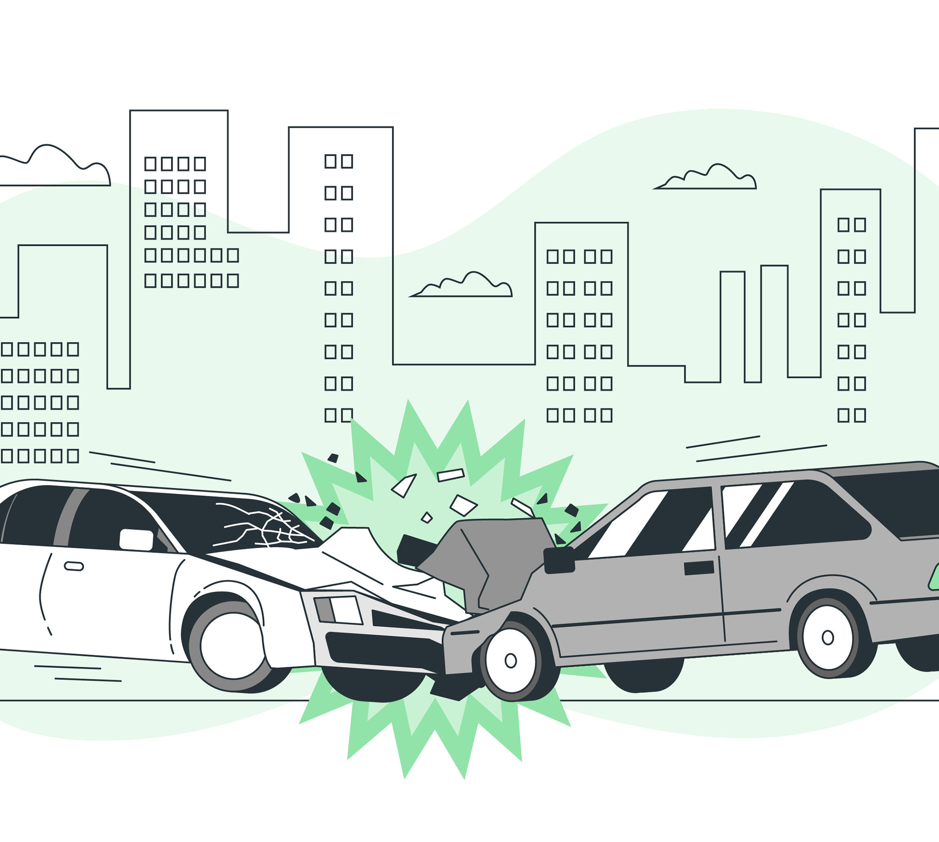
Traffic Accident Prediction
By-
SAHIL KHURANA(E23CSEU2380)
ABHAY GOEL(E23CSEU2381)
DEVANSH BALIYAN(E23CSEU2385)

Slide 2

Introduction
The majority of fatalities and serious injuries occur as a result of incidents involving motor vehicles. If the traffic management system is going to do its job of reducing the frequency and severity of traffic accidents, it needs a model for doing so. In this model, we combine the results of four machine learning algorithms—logistic regression, decision tree, naïve bayes and random forest classifier—to build a predictive model. In order to forecast the severity of accidents in different regions, we used ML algorithms on a dataset of accidents from the United States. In addition, we examine vast quantities of traffic data, extracting helpful accident patterns in order to pinpoint the factors that have a direct bearing on road accidents and make actionable suggestions for improvement.

Slide 3

Problem Statement
1. Objective
Predict the likelihood and severity of traffic accidents based on various factors such as location, time, and weather conditions.
Classify accidents to help inform preventative actions and improve response times.
2. Challenges
Data Complexity: Accidents are influenced by multiple, sometimes unpredictable factors.
Data Availability: Limited access to consistent, high-quality real-time data.
Pattern Variability: Accident patterns vary widely by location and time, making prediction complex.

Slide 4

Data Collection
In order to forecast the severity of accidents in different regions, we used ML algorithms on a dataset of accidents from the United States.
We have used Kaggle for the Dataset, we examine vast quantities of traffic data, extracting helpful accident patterns in order to pinpoint the factors that have a direct bearing on road accidents and make actionable suggestions for improvement

Slide 5
DATA PREPROCESSING
1. Data Cleaning
Handling Missing Values: Imputed missing data in features like weather conditions and road types.
Removing Duplicates: Eliminated duplicate entries to ensure data accuracy.
2. Feature Engineering
New Features: Created additional features such as peak hours, seasonal variations, and road risk scores.
Categorical Encoding: Converted categorical data (e.g., road type, weather) into numerical values for modeling.
3. Normalization and Scaling
Consistency: Applied normalization and scaling to features (e.g., traffic volume, accident severity) to standardize inputs for the model.

Slide 6
Exploratory Data Analysis (EDA)
1. Accident Trends
Time Patterns: Higher accident rates during specific times (e.g., rush hours, weekends).
Location Insights: Certain areas (e.g., intersections, highways) show higher accident frequencies.
2. Correlations
Weather and Accidents: Notable increase in accidents during adverse weather (e.g., rain, snow).
Time of Day and Severity: Nighttime accidents often have higher severity due to visibility issues.
3. Visualizations
Graphs and Charts: Display accident trends by time of day, weather conditions, and accident severity levels using bar charts and heatmaps.

Slide 7
Model Used
Naïve Bayes
Logistic regression
Decision tree
Random forest classifier

Slide 8

Train-Test Splitting
1. Overview
Data Splitting: The dataset is split with 86% of the data reserved for testing and 14% for training.
Training Set: 14% of the data used to train the model.
Test Set: 86% of the data used for model evaluation.
2. Purpose of Each Split
Training Set: Used to train the model, allowing it to learn patterns from the data.
Test Set: Used to evaluate model performance, providing a real-world assessment of how well the model generalizes to unseen data.

Slide 9
Model Evaluation and Results
1. Evaluation Metrics
Accuracy: Percentage of correct predictions out of all predictions.
Precision: Proportion of true positive predictions among all positive predictions.
Recall: Proportion of true positives identified by the model.
F1-Score: Harmonic mean of precision and recall, balancing both metrics.
2. Results Summary
Performance Comparison: Table or graph comparing performance metrics for different models (e.g., Logistic Regression, Random Forest, Neural Network).
Best Model: Identify the top-performing model based on evaluation metrics (e.g., Random Forest with the highest F1-Score).
3. Visualizations
Confusion Matrix: Visual representation of true positives, false positives, true negatives, and false negatives.

Slide 10

Web Application
1. Web Application Overview
Flask Framework: Used Flask to build a lightweight web application for deploying the traffic accident prediction model.
Interactive Interface: Allows users to input factors like weather, time, and location to predict accident likelihood.
2. Features of the Application
User Input: Form to enter accident-related features (e.g., weather conditions, traffic volume, time of day).
Real-Time Prediction: Model processes input data and provides real-time predictions of accident occurrence and severity.
Results Display: Visual representation of results, including accident probability and severity classification.
3. Integration with the Model
Model Integration: The trained machine learning model is integrated with Flask to make predictions based on user input.

Slide 11

Thank You

